Slide 1

Fundamentals of Python:
First Programs
Chapter 5:
Lists and Dictionaries

Slide 2

Objectives
After completing this chapter, you will be able to:
Construct lists and access items in those lists
Use methods to manipulate lists
Perform traversals of lists to process items in the lists
Define simple functions that expect parameters and return values
Fundamentals of Python: First Programs

Slide 3
Objectives (continued)
Construct dictionaries and access entries in those dictionaries
Use methods to manipulate dictionaries
Decide whether a list or a dictionary is an appropriate data structure for a given application
Fundamentals of Python: First Programs

Slide 4
Introduction
A list allows the programmer to manipulate a sequence of data values of any types
A dictionary organizes data values by association with other data values rather than by sequential position
Lists and dictionaries provide powerful ways to organize data in useful and interesting applications
Fundamentals of Python: First Programs

Slide 5
Lists
List: Sequence of data values (items or elements)
Some examples:
  Shopping list for the grocery store
  Guest list for a wedding
  Recipe, which is a list of instructions
  Text document, which is a list of lines
  Words in a dictionary
Each item in a list has a unique index that specifies its position (from 0 to length – 1)
Fundamentals of Python: First Programs

Slide 6
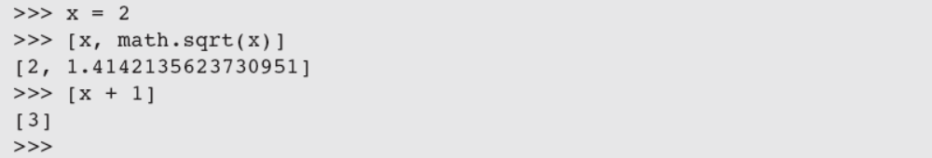
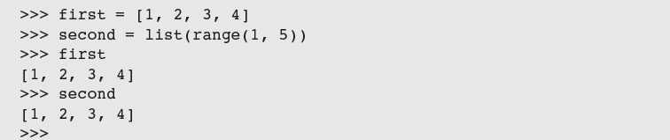
List Literals and Basic Operators
Some examples:
  ['apples', 'oranges', 'cherries']
  [[5, 9], [541, 78]]
When an element is an expression, its value is included in the list:
Lists of integers can be built using range:
Fundamentals of Python: First Programs

Slide 7
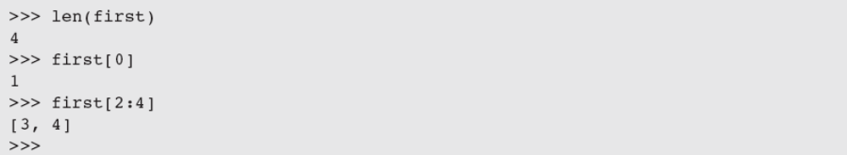
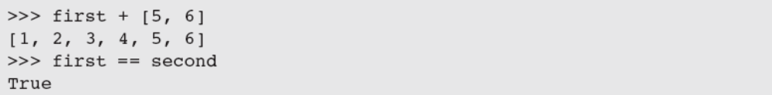
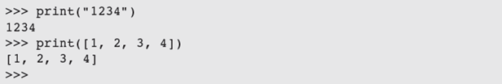
List Literals and Basic Operators (continued)
len, [], +, and == work on lists as expected:
To print the contents of a list:
in detects the presence of an element:
Fundamentals of Python: First Programs

Slide 8
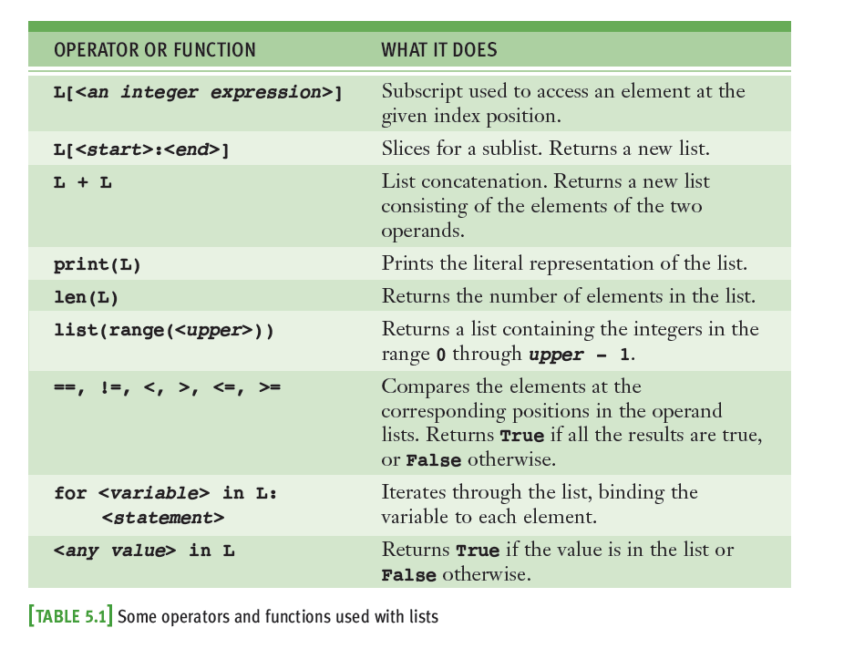
List Literals & Basic Operators (cont.)
Fundamentals of Python: First Programs

Slide 9
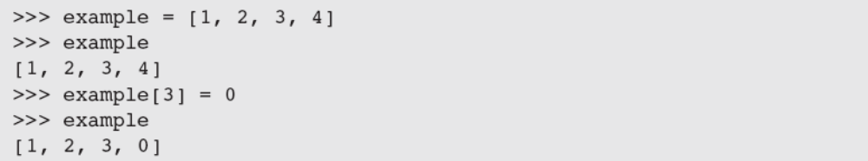
Replacing an Element in a List
A list is mutable
  Elements can be inserted, removed, or replaced
  The list itself maintains its identity, but its state—its length and its contents—can change
Subscript operator is used to replace an element:
  Subscript is used to reference the target of the assignment, which is not the list but an element’s position within it
Fundamentals of Python: First Programs

Slide 10
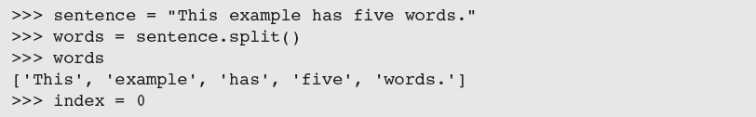
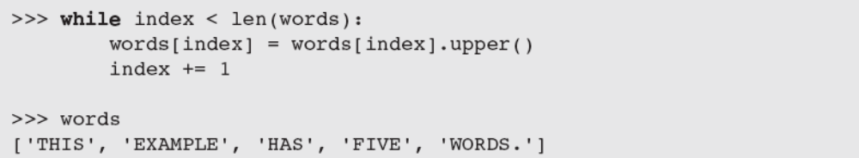
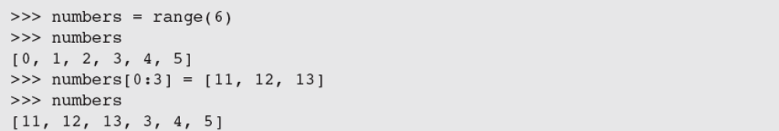
Replacing an Element in a List (continued)
Examples:
Fundamentals of Python: First Programs

Slide 11
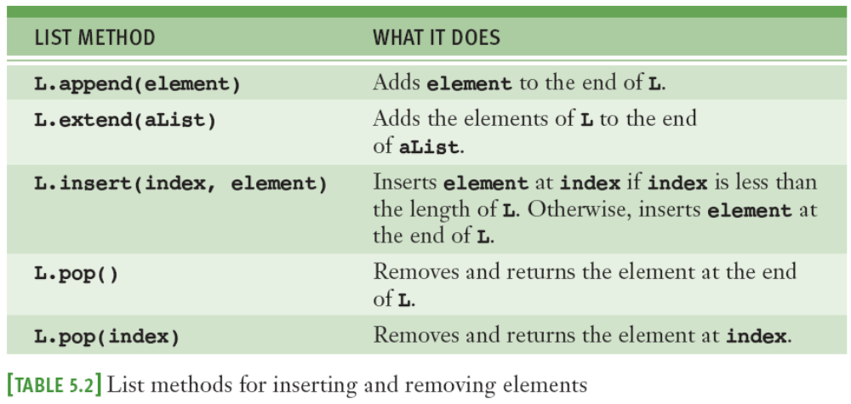
List Methods for Inserting and Removing Elements
The list type includes several methods for inserting and removing elements
Fundamentals of Python: First Programs

Slide 12
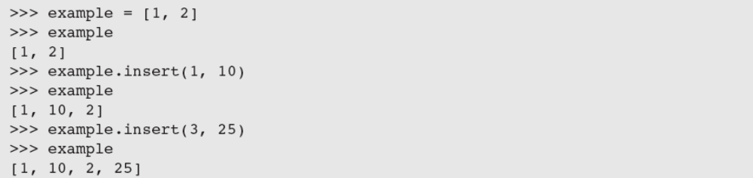
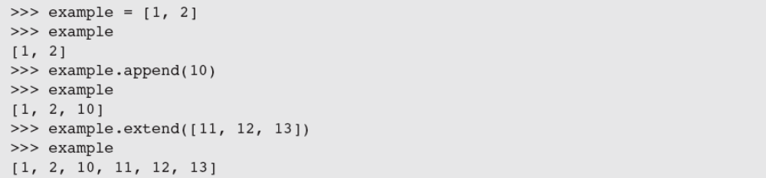
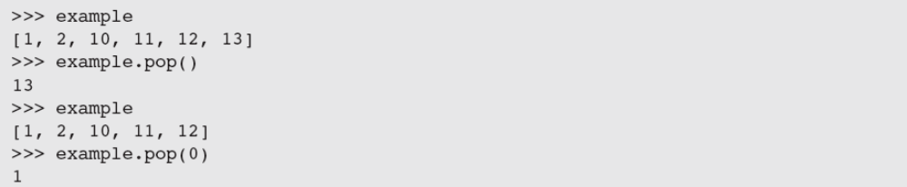
List Methods for Inserting and Removing Elements (continued)
Fundamentals of Python: First Programs

Slide 13
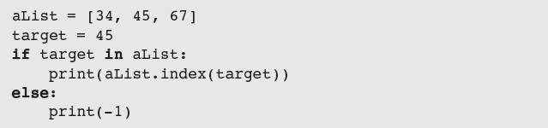
Searching a List
in determines an element’s presence or absence, but does not return position of element (if found)
Use method index to locate an element’s position in a list
  Raises an error when the target element is not found
Fundamentals of Python: First Programs

Slide 14
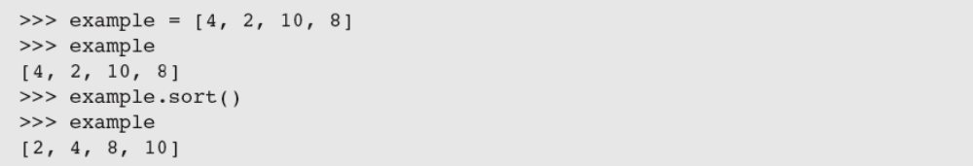
Sorting a List
A list’s elements are always ordered by position, but you can impose a natural ordering on them
  For example, in alphabetical order
When the elements can be related by comparing them <, >, and ==, they can be sorted
  The method sort mutates a list by arranging its elements in ascending order
Fundamentals of Python: First Programs

Slide 15
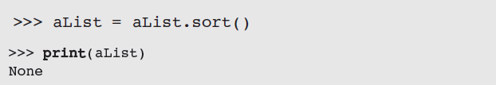
Mutator Methods and the Value None
All of the functions and methods examined in previous chapters return a value that the caller can then use to complete its work
Mutator methods (e.g., insert, append) usually return no value of interest to caller
  Python automatically returns the special value None
Fundamentals of Python: First Programs

Slide 16
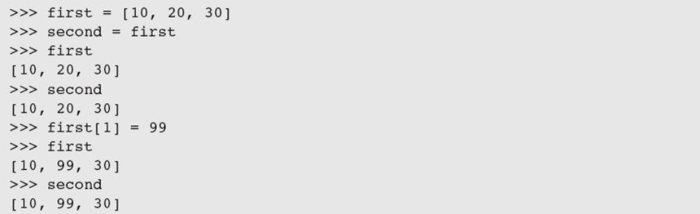
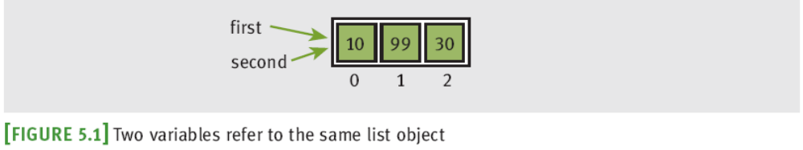
Aliasing and Side Effects
Mutable property of lists leads to interesting phenomena:
first and second are aliases
(refer to the exact same list object)
Fundamentals of Python: First Programs

Slide 17
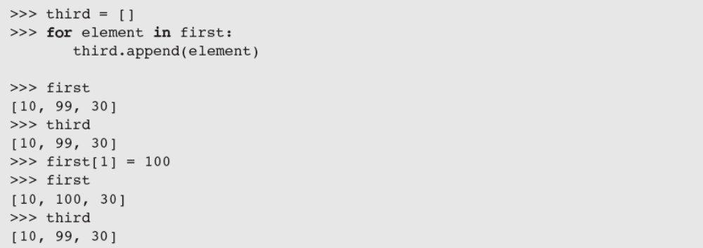
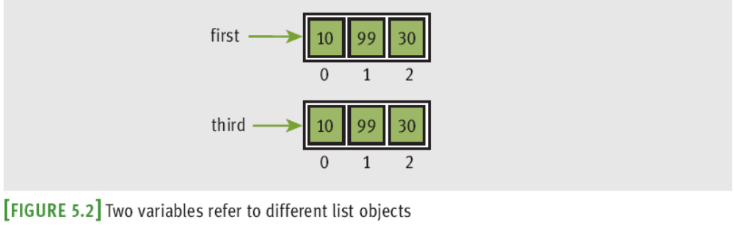
Aliasing and Side Effects (continued)
To prevent aliasing, copy contents of object:
Alternative:
Fundamentals of Python: First Programs

Slide 18
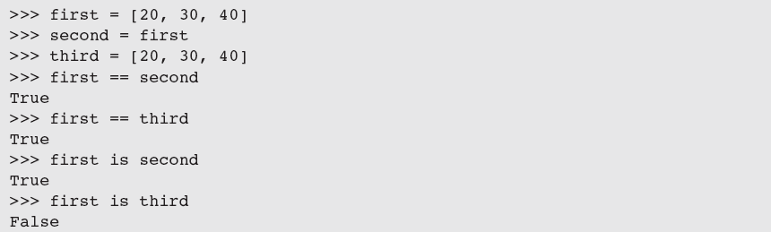
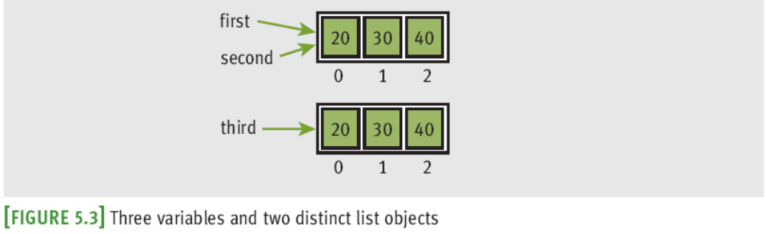
Equality: Object Identity and Structural Equivalence
Fundamentals of Python: First Programs

Slide 19
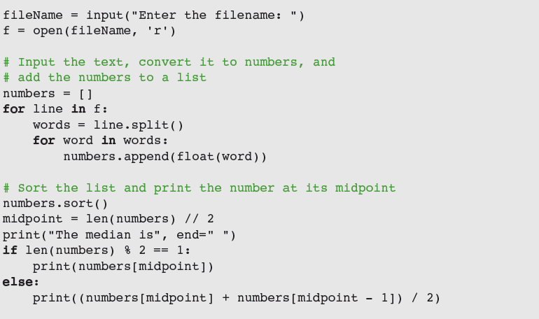
Example: Using a List to Find the Median of a Set of Numbers
To find the median of a set of numbers:
Fundamentals of Python: First Programs

Slide 20
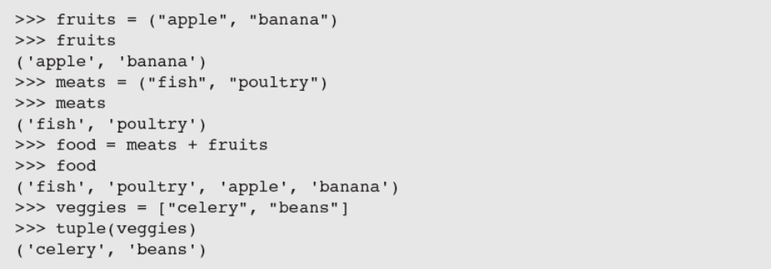
Tuples
A tuple resembles a list, but is immutable
  Indicate by enclosing its elements in ()
Most of the operators and functions used with lists can be used in a similar fashion with tuples
Fundamentals of Python: First Programs

Slide 21
Defining Simple Functions
Defining our own functions allows us to organize our code in existing scripts more effectively
Fundamentals of Python: First Programs

Slide 22
The Syntax of Simple Function Definitions
Definition of a function consists of header and body
  Docstring contains information about what the function does; to display, enter help(square)
A function can be defined in a Python shell, but it is more convenient to define it in an IDLE window
Syntax of a function definition:
Fundamentals of Python: First Programs

Slide 23
Parameters and Arguments
A parameter is the name used in the function definition for an argument that is passed to the function when it is called
For now, the number and positions of arguments of a function call should match the number and positions of the parameters in the definition
Some functions expect no arguments
  They are defined with no parameters
Fundamentals of Python: First Programs

Slide 24
The return Statement
Place a return statement at each exit point of a function when function should explicitly return a value
Syntax:
If a function contains no return statement, Python transfers control to the caller after the last statement in the function’s body is executed
  The special value None is automatically returned
Fundamentals of Python: First Programs

Slide 25
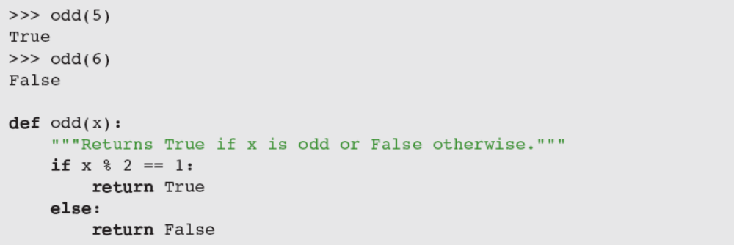
Boolean Functions
A Boolean function usually tests its argument for the presence or absence of some property
  Returns True if property is present; False otherwise
Example:
Fundamentals of Python: First Programs

Slide 26
Defining a main Function
main serves as the entry point for a script
  Usually expects no arguments and returns no value
Definition of main and other functions can appear in no particular order in the script
  As long as main is called at the end of the script
Script can be run from IDLE, imported into the shell, or run from a terminal command prompt
Fundamentals of Python: First Programs

Slide 27
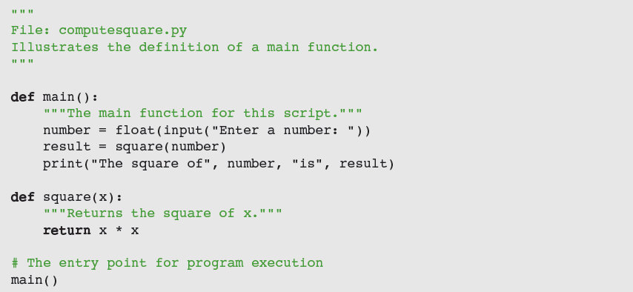
Defining a main Function (continued)
Fundamentals of Python: First Programs

Slide 28
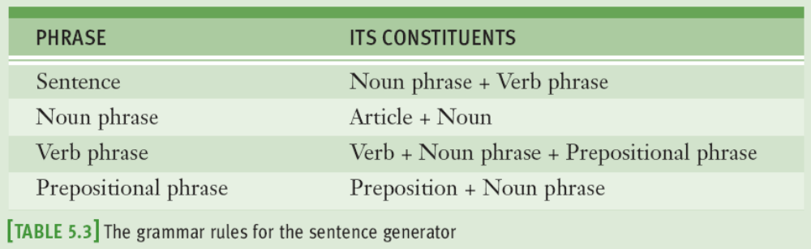
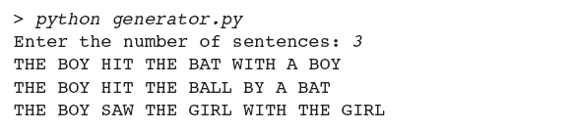
Case Study: Generating Sentences
Request: write a program that generates sentences
Analysis: program will generate sentences from a simplified subset of English
Fundamentals of Python: First Programs

Slide 29


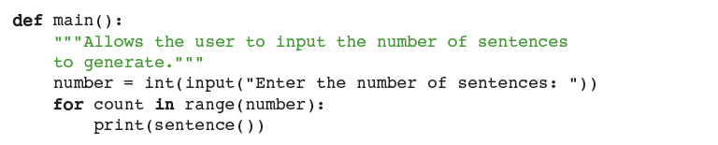
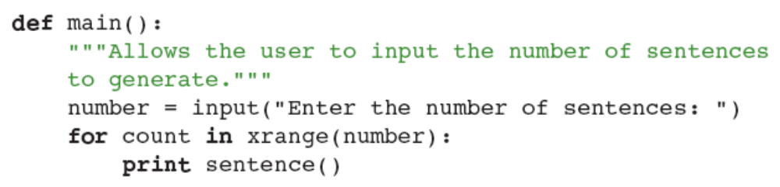
Case Study: Generating Sentences (continued)
Design:
  Assign task of generating each phrase to a separate function
Fundamentals of Python: First Programs

Slide 30
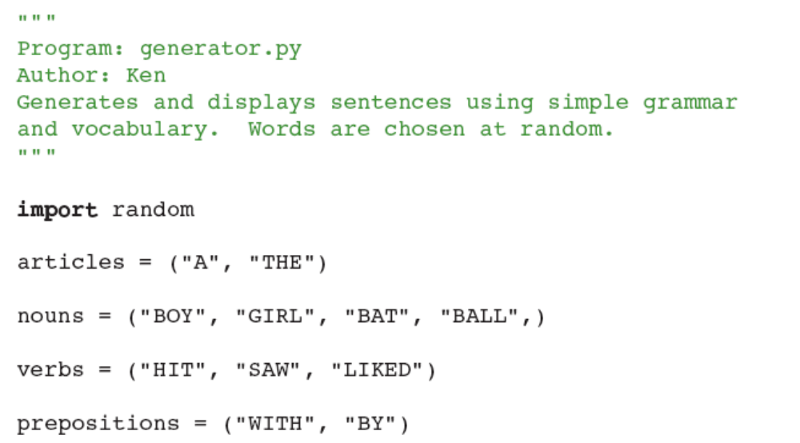
Case Study: Generating Sentences (continued)
Implementation (coding):
  The variables for the data are initialized just below the import statement
Fundamentals of Python: First Programs

Slide 31
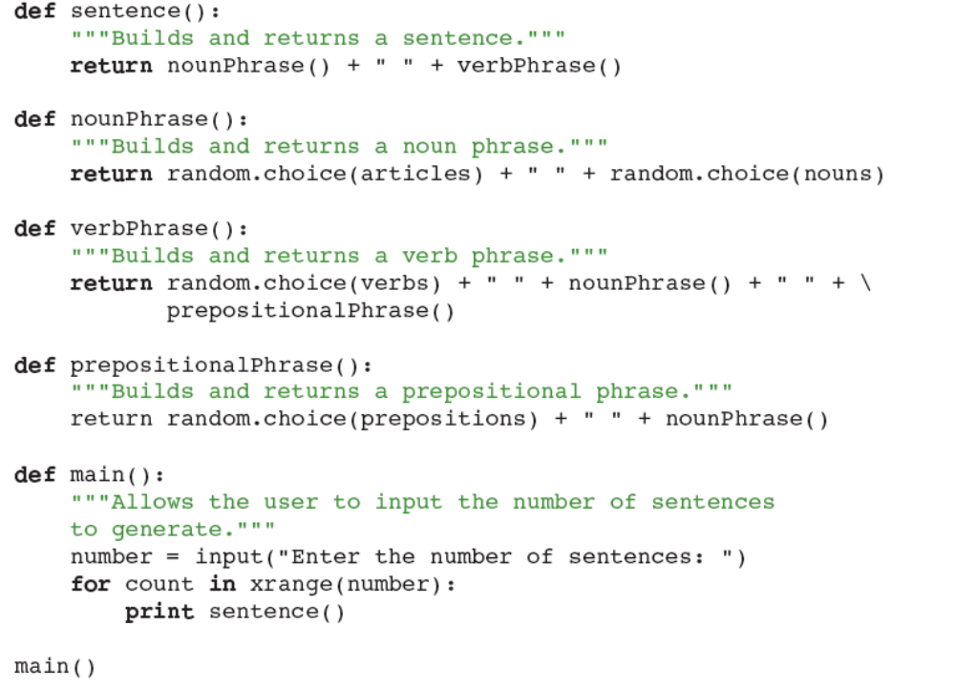
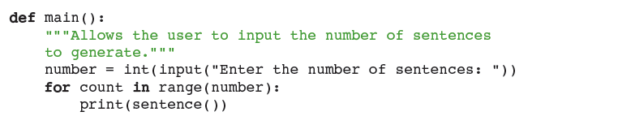
Case Study: Generating Sentences (continued)
Fundamentals of Python: First Programs

Slide 32
Case Study: Generating Sentences (continued)
Testing:
  Two approaches:
    Bottom-up
    Top-down
  Wise programmer can mix bottom-up and top-down testing as needed
Fundamentals of Python: First Programs

Slide 33
Dictionaries
A dictionary organizes information by association, not position
  Example: When you use a dictionary to look up the definition of “mammal,” you don’t start at page 1; instead, you turn to the words beginning with “M”
Data structures organized by association are also called tables or association lists
In Python, a dictionary associates a set of keys with data values
Fundamentals of Python: First Programs

Slide 34
Dictionary Literals
A Python dictionary is written as a sequence of key/value pairs separated by commas
  Pairs are sometimes called entries
  Enclosed in curly braces ({ and })
  A colon (:) separates a key and its value
Examples:
  {'Sarah':'476-3321', 'Nathan':'351-7743'} A Phone book
  {'Name':'Molly', 'Age':18} Personal information
  {} An empty dictionary
Keys can be data of any immutable types, including other data structures
Fundamentals of Python: First Programs

Slide 35
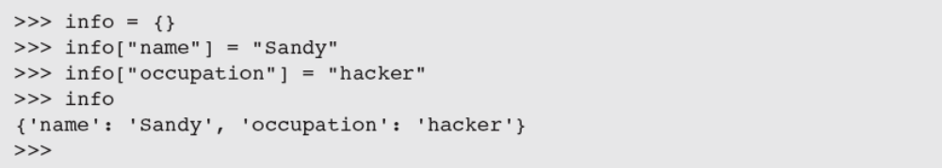
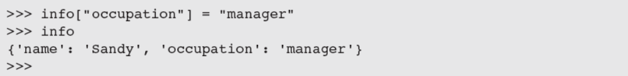
Adding Keys and Replacing Values
Add a new key/value pair to a dictionary using []:
Example:
Use [] also to replace a value at an existing key:
Fundamentals of Python: First Programs

Slide 36
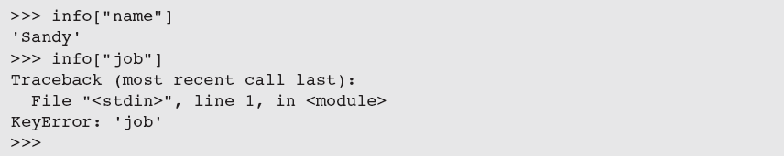

Accessing Values
Use [] to obtain the value associated with a key
  If key is not present in dictionary, an error is raised
If the existence of a key is uncertain, test for it using the dictionary method has_key
  Easier strategy is to use the method get
Fundamentals of Python: First Programs

Slide 37
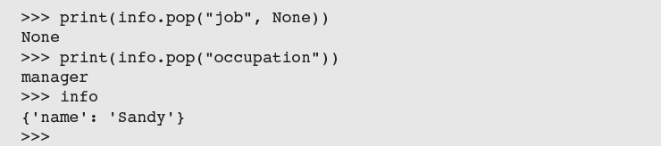
Removing Keys
To delete an entry from a dictionary, remove its key using the method pop
  pop expects a key and an optional default value as arguments
Fundamentals of Python: First Programs

Slide 38
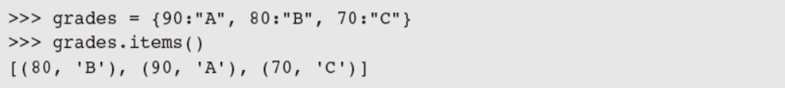
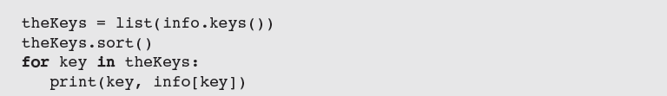
Traversing a Dictionary
To print all of the keys and their values:
Alternative: Use the dictionary method items()
  Entries are represented as tuples within the list
You can sort the list first:
Fundamentals of Python: First Programs

Slide 39
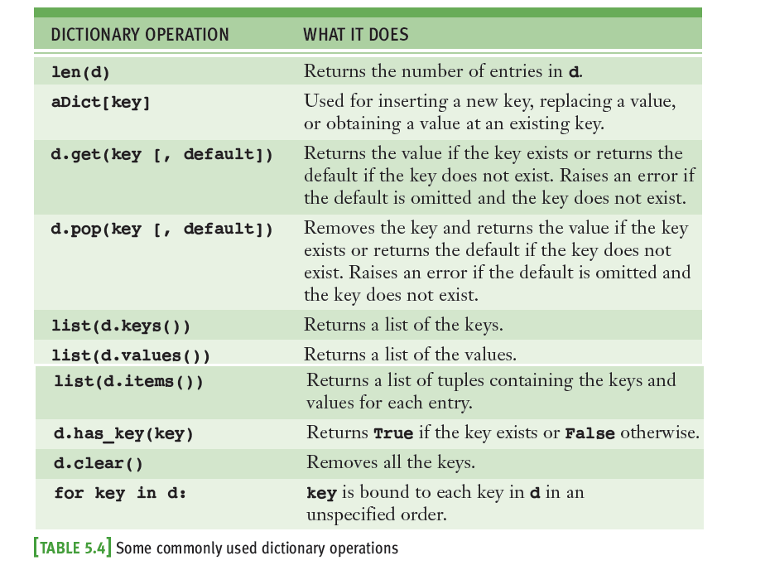
Traversing a Dictionary (continued)
Fundamentals of Python: First Programs

Slide 40
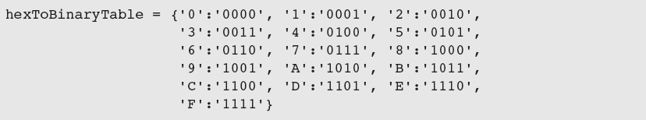
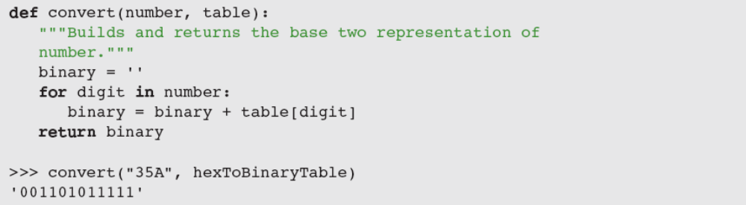
Example: The Hexadecimal System Revisited
You can keep a hex-to-binary lookup table to aid in the conversion process
Fundamentals of Python: First Programs

Slide 41
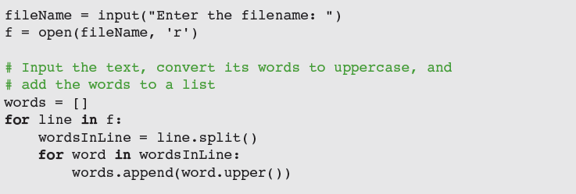
Example: Finding the Mode of a List of Values
The mode of a list of values is the value that occurs most frequently
The following script inputs a list of words from a text file and prints their mode
Fundamentals of Python: First Programs

Slide 42
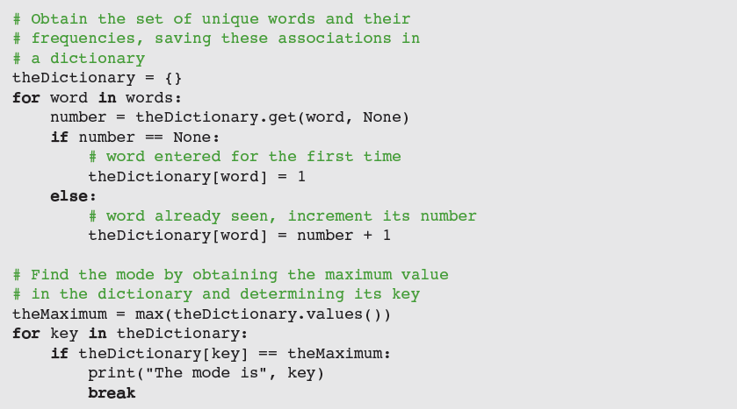
Example: Finding the Mode of a List of Values (continued)
Fundamentals of Python: First Programs

Slide 43
Case Study: Nondirective Psychotherapy (Request)
Doctor in this kind of therapy responds to patient’s statements by rephrasing them or indirectly asking for more information
Request:
  Write a program that emulates a nondirective psychotherapist
Fundamentals of Python: First Programs

Slide 44
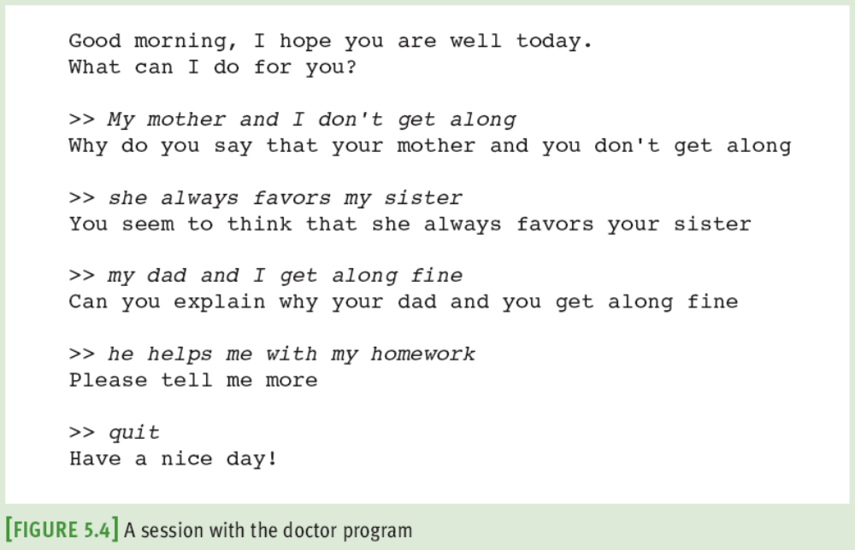
Case Study: Nondirective Psychotherapy (Analysis)
Fundamentals of Python: First Programs

Slide 45
Case Study: Nondirective Psychotherapy (Analysis) (continued)
When user enters a statement, program responds in one of two ways:
  With a randomly chosen hedge, such as “Please tell me more”
  By changing some key words in user’s input string and appending string to a randomly chosen qualifier
    Thus, to “My teacher always plays favorites,” program might reply, “Why do you say that your teacher always plays favorites?”
Fundamentals of Python: First Programs

Slide 46
Case Study: Nondirective Psychotherapy (Design)
Program consists of a set of collaborating functions that share a common data pool
Pseudocode:
  output a greeting to the patient
  while True
    prompt for and input a string from the patient
    if the string equals “Quit”
      output a sign-off message to the patient
      break
    call another function to obtain a reply to this string
    output the reply to the patient
Fundamentals of Python: First Programs

Slide 47
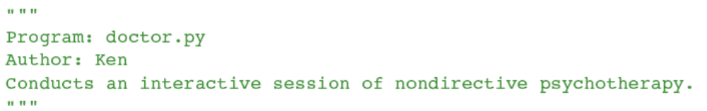
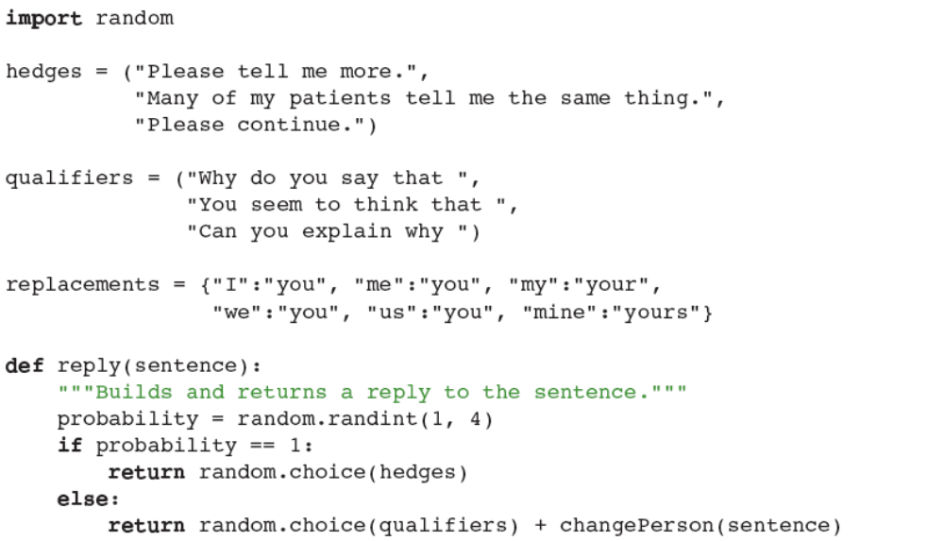
Case Study: Nondirective Psychotherapy (Implementation)
Fundamentals of Python: First Programs

Slide 48
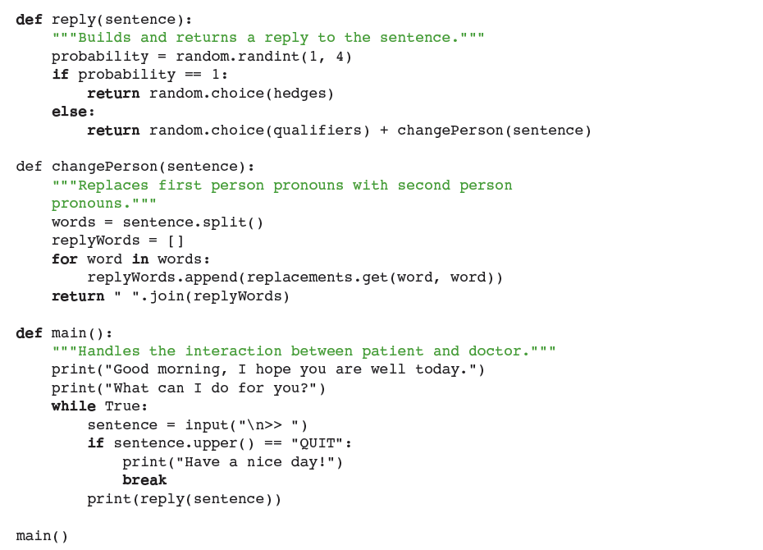
Case Study: (Implementation, cont.)
Fundamentals of Python: First Programs

Slide 49
Case Study: Nondirective Psychotherapy (Testing)
Functions in this program can be tested in a bottom-up or a top-down manner
Program’s replies break down when:
  User addresses the therapist in the second person
  User uses contractions (for example, I’m and I’ll)
With a little work, you can make the replies more realistic
Fundamentals of Python: First Programs

Slide 50
Summary
A list is a sequence of zero or more elements
  Can be manipulated with the subscript, concatenation, comparison, and in operators
  Mutable data structure
  index returns position of target element in a list
  Elements can be arranged in order using sort
Mutator methods are called to change the state of an object; usually return the value None
Assignment of a variable to another one causes both to refer to the same data object (aliasing)
Fundamentals of Python: First Programs

Slide 51
Summary (continued)
A tuple is similar to a list, but is immutable
A function definition consists of header and body
  return returns a value from a function definition
A dictionary associates a set of keys with values
  [] is used to add a new key/value pair to a dictionary or to replace a value associated with an existing key
  dict type includes methods to access and remove data in a dictionary
Testing can be bottom-up, top-down, or you can use a mix of both
Fundamentals of Python: First Programs

